Slide 1

ECE 281
Digital Design and Computer Architecture Lecture 1
Maj Jeffrey Falkinburg Room 2E46E 333-9193
402-312-8078
1

Slide 2
Your first assignment…
Name Major
Hometown Desired AFSC/ Job
Interests Clubs/IC Sports
What you want me to do
What you want from this class
What you have heard about this class
Notes:
Fill out seating chart

Slide 3
Who you are
T3A
Computer Engineers – 3
Electrical Engineers – 2
Systems Engineer – 1
Computer Network Security – 4

Slide 4
Who am I?
Education
BSCE, University of Nebraska Lincoln – Omaha Campus
MSCE, Air Force Institute of Technology (AFIT)
USAF Career (62E3C, T62E3E, 62E3A, 3CO31, 2E231)
Prior Enlisted 9.5 yrs
3rd Combat Communication Group – Tinker AFB, OK
Operation Southern Watch – Eskan Village, Saudi Arabia
55th Communications Group – Offutt AFB, NE
School/AFROTC/AECP – University of Nebraska
Air Force Research Labs (AFRL) – Munitions Directorate – Eglin AFB, FL
Operation Iraqi Freedom – Al Asad, Iraq
School – AFIT
711 Human Performance Wing (HPW) – Wright Patterson AFB, OH
Interests
Spending time with my Family, computers, watching movies, woodworking, getting outside

Slide 5

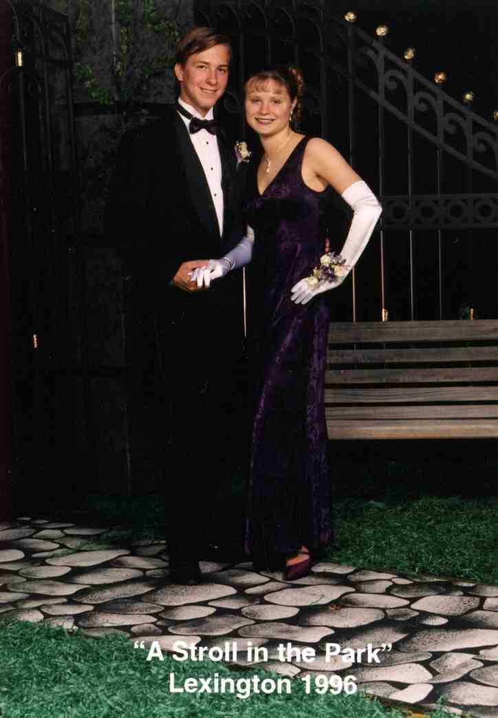
Grew up in Nebraska
Enlisted in 1998

Slide 6
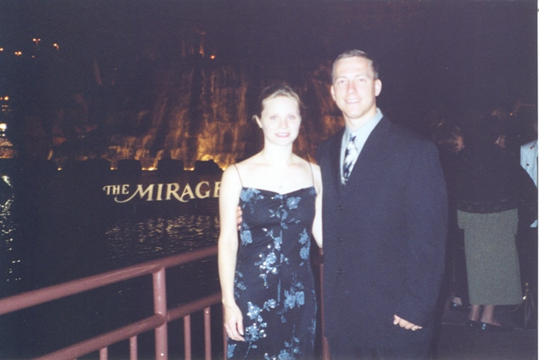


3rd Combat Communications Group – Tinker AFB, OK
1998 - 2002

Slide 7
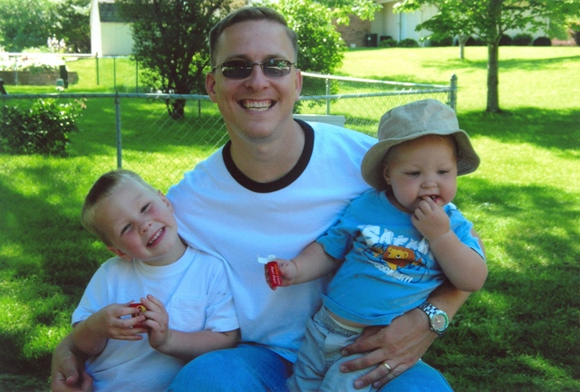


55th Communications Group – Offutt AFB, NE
2002 - 2004

Slide 8
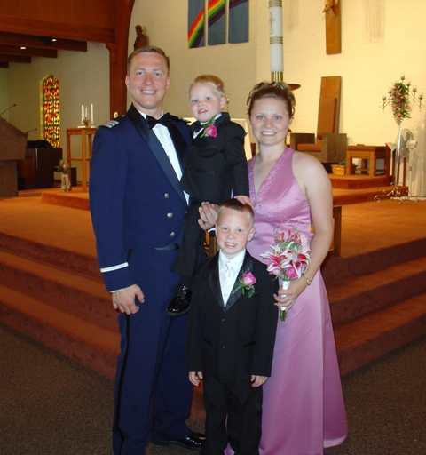
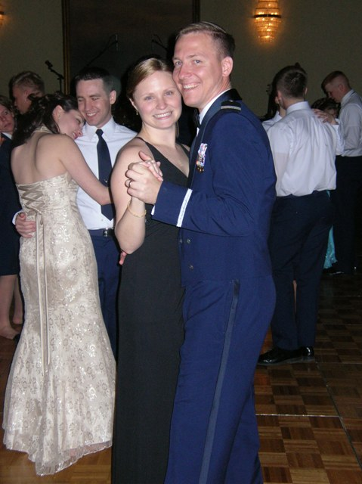

AFROTC Detachment 470 – University of Nebraska
2004 - 2007

Slide 9

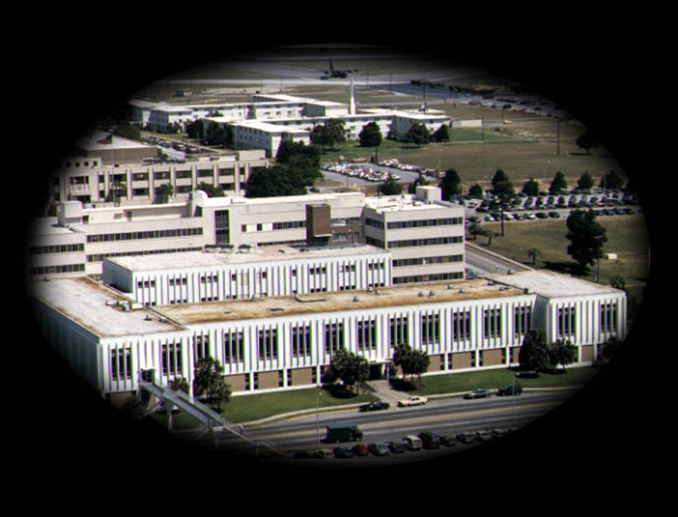


Air Force Research Labs –Eglin AFB, FL
2007 - 2009

Slide 10



Air Force Institute of Technology (AFIT) – Wright Patterson AFB, OH
2009 - 2011

Slide 11



711 Human Performance Wing – Wright Patterson AFB, OH
2011 - 2014

Slide 12




USAFA Instructor
2014 - Present

Slide 13

Why I do what I do
Britney, Dillon, and Brendan

Slide 14
Extra Instruction (EI)
Capt Jeffrey Falkinburg
2E46E
Office: 333-7366
Cell: 402-312-8078
M1
ECE 281 – 2F44
T1
M2
ECE 281 – 2F44
T2
M3
ECE 463 – 2G2
T3
ECE 383 – 2E48A
M4
ECE 463 – 2G2
T4
ECE 383 – 2E48A
Available
M5
T5
Sometimes Available
M6
ECE 383 – 2E48A
T6
Always Unavailable
M7
ECE 383 – 2E48A
T7

Slide 15
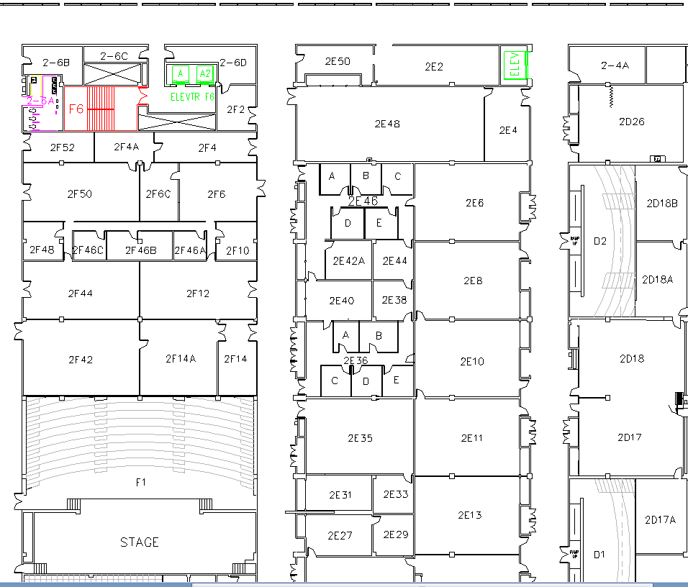
West (Terrazzo) Side

Slide 16
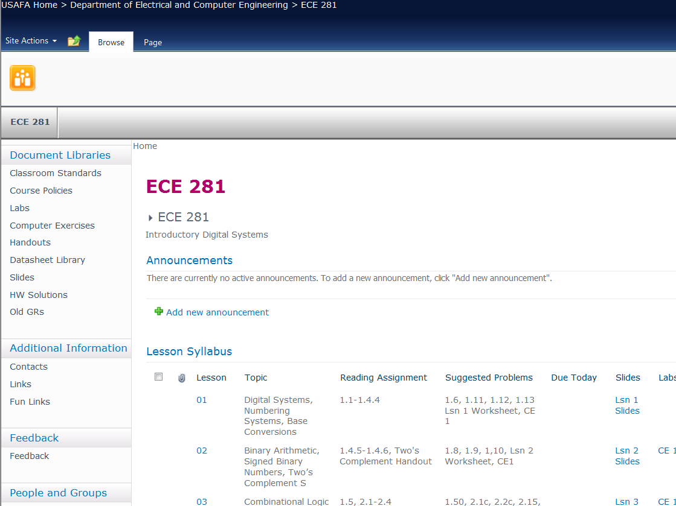
Course Website
Course Web Site https://sharepoint.usafa.edu/academics/eleccompengineering/ece281/default.aspx

Slide 17
Course Goals
The goals of this course are for all cadets enrolled in the course to develop the ability to understand and design combinational and sequential circuits and construct, test, and debug these circuits using small and medium scale integrated circuits.
Cadets shall demonstrate an understanding of basic computer architecture and how a computer executes simple programs.

Slide 18
Course Objectives
Demonstrate ability to apply knowledge of math, science, and engineering to analyze combinational and sequential digital circuits.
Demonstrate ability to use small and medium scale integrated circuits to design, construct, test, and debug combinational and sequential circuits.
Demonstrate ability to design combinational and sequential circuits using a hardware description language.
Demonstrate the ability to compile, synthesize, and implement circuit designs on a Field Programmable Gate Array.
Demonstrate ability to write basic assembly language programs, and analyze program execution on a simple computer.
Demonstrate the ability to properly record and report laboratory work.

Slide 19
Course Topics
Block I
Basic combinational logic
Sequential Logic
Block II
VHDL
Digital Building Blocks
Block III
Computer architecture

Slide 20
Grade Distribution
 | Prog | Final
GRs (2) | 40 % | 25 % |  | Grade | Grade
Labs (4) | 30 % | 25 % |  | 90 ≤ A ≤ 100 | 74 ≤ C+ < 77
Computer Exercises (4) | 20 % | 15 % |  | 87 ≤ A- < 90 | 70 ≤ C < 74
Quizzes & Homework | 10 % | 10 % |  | 84 ≤ B+ < 87 | 67 ≤ C- < 70
Final Exam |  | 25 % |  | 80 ≤ B < 84 | 60 ≤ D < 67
 |  |  |  | 77 ≤ B- < 80 | F < 60
TOTAL | 100 % | 100 %
Note: you have to get a 60% weighted average on the GRs and Final to pass the course.

Slide 21
Late Policy
How Late? |  | Penalty | Max Grade
1 calendar day | < 24 hrs | 25% | 75%
2 days | 24 to 48 hrs | 50% | 50%
3 days | 48 to 72 hrs | 75% | 25%
4 days or more | 72 + hrs | 100% | 0%
Note: Late time includes weekends and holidays. Make prior arrangements for weekend or holiday turn-in. All assigned work must be turned in to pass the course—even if it’s too late to receive any credit.

Slide 22
Course Text Policy
The required textbook for this course is Digital Design Principles and Computer Architecture Second Edition, by David Money Harris & Sarah L. Harris.
Software: Xilinx ISE 14.7

Slide 23
Other Course Policies - Labs
Bitbucket to turn in lab materials bitbucket.org
Class time is provided, but come prepared!
The labs will require debugging—53 minutes goes by quickly
Do the prelab, if there is one
There’s a late penalty for each prelab section not completed before you come to class

Slide 24
Other Course Policies
Extra Instruction
Seek EI from me or another instructor
Send a meeting request to set up a time; be sure to let me know if you cancel
Attempt the work before you come
CAS
Precoordinate absences if at all possible
A CAS code doesn’t necessarily mean you’re excused from class (instructor “notification” vs “permission”)

Slide 25
Other Course Policies
Collaboration
Check the collaboration policy on each assignment
Generally OK to collaborate on homework, computer exercises, labs, and preflights—but all written work, including code, must be in your own words
Document any help/collaboration
Quizzes, GRs, and Final
Let me know at least one lesson ahead of time if you’re going to miss a graded evaluation
Computer Exercises
Familiarize you with the software used in the course. You will have to use what you learn when you do the labs

Slide 26
Academics with Honor
Which homework below is considered cheating under the Honor Code?
A 6-page paper which does not have a documentation statement.
A 4-page paper which documents that Cadet X helped the cadet with a specific issue on Problem 5 when the paper was supposed to be individual effort.
A 10-page paper turned in which contains 35 footnotes, but one of them is attributed to the wrong source.
An 8-page paper which Turn-it-in.com shows to contain 4 pages of material that is taken from an internet source but it is not quoted nor the internet source documented

Slide 27
Abstraction
Hiding details when they aren’t important
Copyright © 2007 Elsevier

Slide 28
The Digital Abstraction
Most physical variables are continuous, for example
Voltage on a wire
Frequency of an oscillation
Position of a mass
Instead of considering all values, the digital abstraction considers only a discrete subset of values
Copyright © 2007 Elsevier

Slide 29
The Three -Y’s
Hierarchy
A system divided into modules and submodules
Modularity
Having well-defined functions and interfaces
Regularity
Encouraging uniformity, so modules can be easily reused
Copyright © 2007 Elsevier

Slide 30
Number Systems Expanded Normal Form
Decimal numbers
Binary numbers
Copyright © 2007 Elsevier

Slide 31
Number Systems
Decimal numbers
Binary numbers
Copyright © 2007 Elsevier

Slide 32
Hexadecimal Numbers
Hex Digit | Decimal Equivalent | Binary Equivalent | Octal Equivalent
0 | 0 | 0000 | 0
1 | 1 | 0001 | 1
2 | 2 | 0010 | 2
3 | 3 | 0011 | 3
4 | 4 | 0100 | 4
5 | 5 | 0101 | 5
6 | 6 | 0110 | 6
7 | 7 | 0111 | 7
8 | 8 | 1000 | 10
9 | 9 | 1001 | 11
A | 10 | 1010 | 12
B | 11 | 1011 | 13
C | 12 | 1100 | 14
D | 13 | 1101 | 15
E | 14 | 1110 | 16
F | 15 | 1111 | 17
Copyright © 2007 Elsevier

Slide 33
Number System Conversions
 | Convert To:
Convert From: | Binary | Octal | Hexadecimal | Decimal
Binary | X | Substitution | Substitution | Summation
Octal | Substitution | X | Substitution | Summation
Hexadecimal | Substitution | Substitution | X | Summation
Decimal | Division | Division | Division | X
Division: Divide a number of larger base by the lower base and assign the remainder as the LSB up to the MSB.
Summation: Use the positional numbering system to multiply the digit by the power of the position (A_{n}b^{n} + A_{n-1}b^{n-1} + … + A₁b¹+ A₀b⁰ = ).
Substitution: The Rule of Threes (for binary ⬄ octal) and the Rule of Fours (for binary ⬄ hexadecimal)

Slide 34
Bits, Bytes, Nibbles…
Bits
Bytes & Nibbles
Bytes
Copyright © 2007 Elsevier

Slide 35
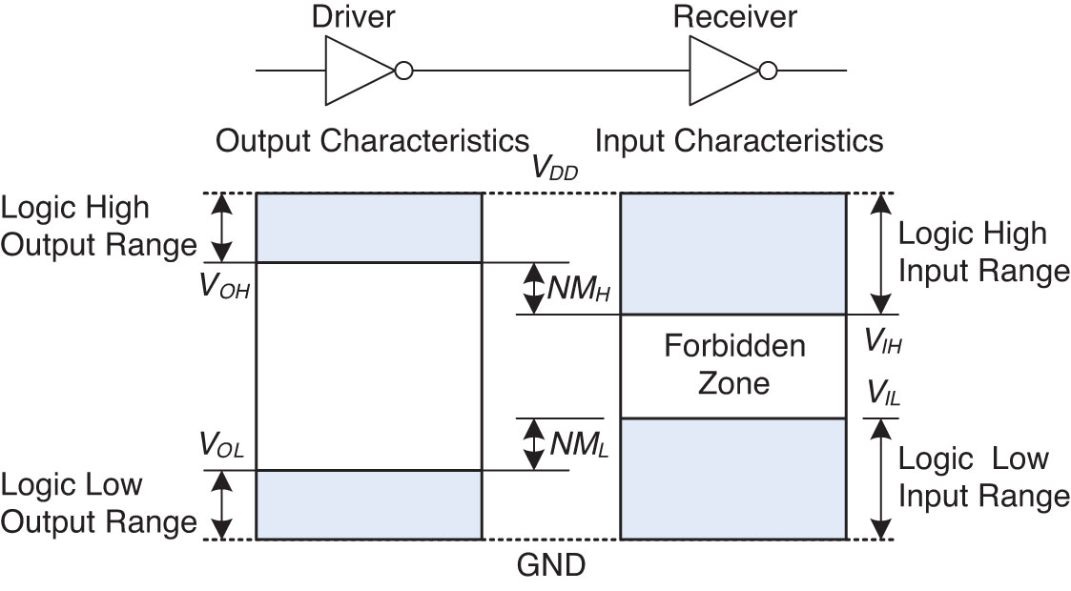
Voltage Levels

Slide 36
Bitbucket
Create Private Bitbucket Repository
https://bitbucket.org/
Name repo something like “ECE281_YourName”
Give me access to repo. My Username: jfalkinburg
Example/Template Lab Notebook:
http://ece.ninja/383/lab/labnotebook.html
https://github.com/jfalkinburg/ECE_382_Lab_Ex/

